Slide 1

Linear Algebra for Machine Learning: Dimensionality Reduction
Mina Farmanbar
Associate Professor, University of Stavanger
for engineers

Slide 2




Dimensionality reduction
Linear Algebra
Data Representation
Vector Embedding
Dimensionality Reduction

Slide 3
Dimensionality reduction
Idea:
Find eigenvectors, or “principal components”

Slide 4
What are Eigenvectors?
We know that vectors have both magnitude and direction when plotted on an XY (2-dim) plane.
Linear transformation of a vector, is the multiplication of a vector with a matrix that changes the basis of the vector and also its direction.

Slide 5

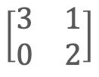

What are Eigenvectors?
When a vector is plotted, it’s direction is along its span.
Now, there are some special vectors, which, when transformed linearly, their directions don’t change.
Instead, they’re either squished or stretched.
Before
After
$$\left[\begin{aligned}−1 \\ 1\end{aligned}\right]$$
$$\left[\begin{matrix}−2 \\ 2\end{matrix}\right]$$
Transform
$$\left[\begin{matrix}3 & 1 \\ 0 & 2\end{matrix}\right]$$

Slide 6
Eigenvectors, eigenvalues
These special vectors are called eigenvectors.
and the scaling factor is called eigenvalues.

Slide 7

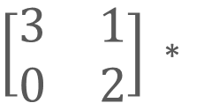

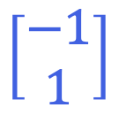
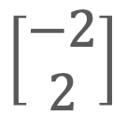
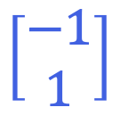

What are Eigenvalues?
They’re simply the constants that increase or decrease the Eigenvectors along their span when transformed linearly.
$\left[\begin{matrix}3 & 1 \\ 0 & 2\end{matrix}\right]$ *
$$\left[\begin{matrix}−1 \\ 1\end{matrix}\right]$$
$$=$$
$$\left[\begin{matrix}−2 \\ 2\end{matrix}\right]$$
$$=$$
$$2$$
$$\left[\begin{matrix}−1 \\ 1\end{matrix}\right]$$
M
V
=
2
V

Slide 8
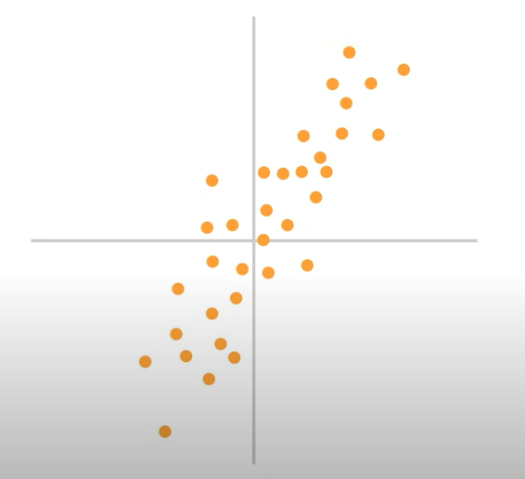
Eigenvectors
Suppose we have n data points in m-dimensional space.
Oftentimes, these points will be clustered along a line or other low-dimensional subspace.
What is that line or subspace?

Slide 9
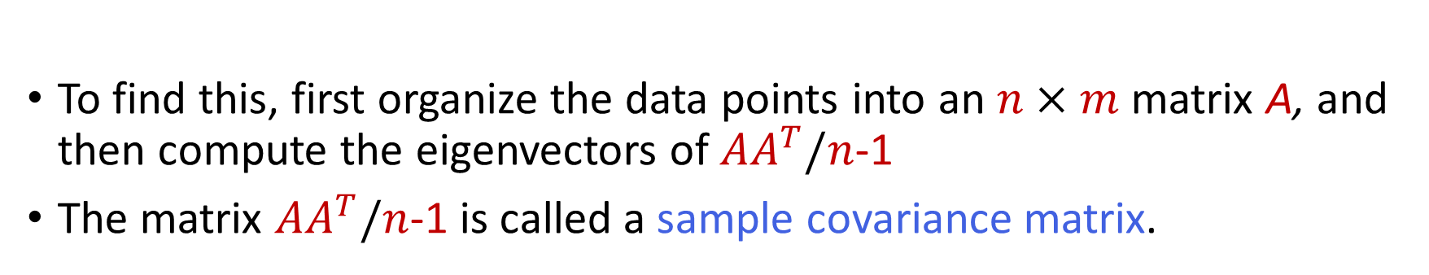
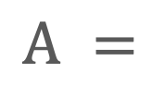
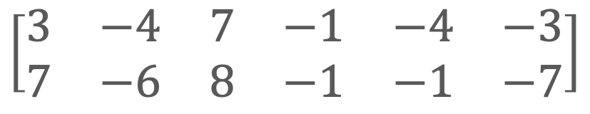
Eigenvectors
To find this, first organize the data points into an $n×m$matrix A, and then compute the eigenvectors of${AA}^{T}/n$-1
The matrix ${AA}^{T}/n$-1 is called a sample covariance matrix.
Student
1
2
3
4
5
6
$$\left[\begin{matrix}3 & −4 & 7 & −1 & −4 & −3 \\ 7 & −6 & 8 & −1 & −1 & −7\end{matrix}\right]$$
Math
$$Α =$$
History
We first centered the data points by subtracting the mean of each row.

Slide 10
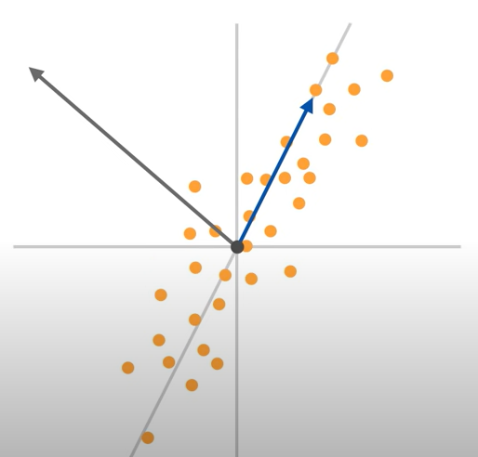

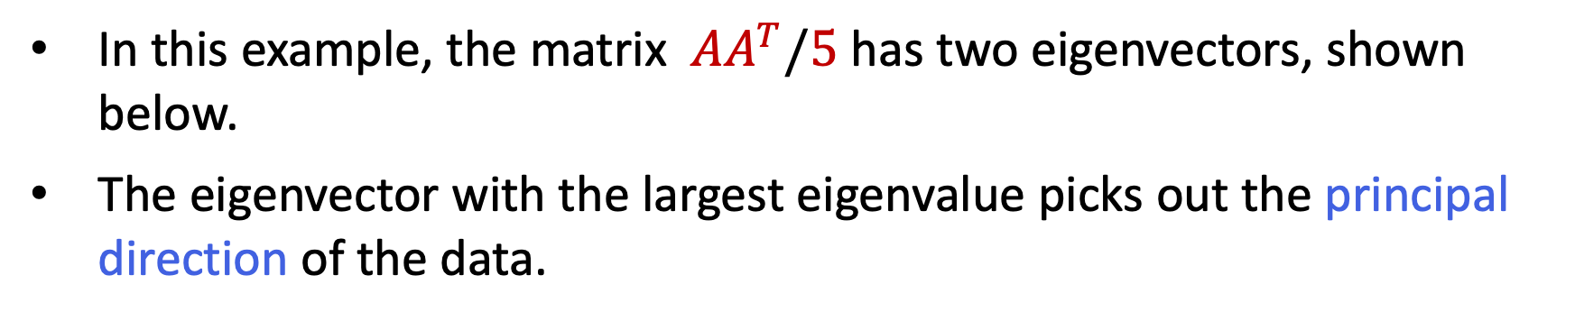

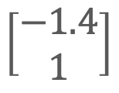


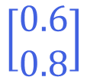
Eigenvectors
In this example, the matrix ${AA}^{T}/5$ has two eigenvectors, shown below.
The eigenvector with the largest eigenvalue picks out the principal direction of the data.
$$e2$$
$$\left[\begin{matrix}−1.4 \\ 1\end{matrix}\right]$$
$$e1$$
$$=$$
$$\left[\begin{matrix}0.6 \\ 0.8\end{matrix}\right]$$
$$=$$
“Scale factor” is 3
“Scale factor” is 57

Slide 11
Summary
Oftentimes, relevant data occupies only a small portion of the ambient large-dimensional vector space.
Working within that smaller space increase efficiency, saves resources, and reveals relevant structure in the data.
Linear algebra, and other dimensionality reduction techniques, can help locate that small space.

Slide 12
Thank you!
Mina Farmanbar
mina.farmanbar@uis.no

